Slide 1
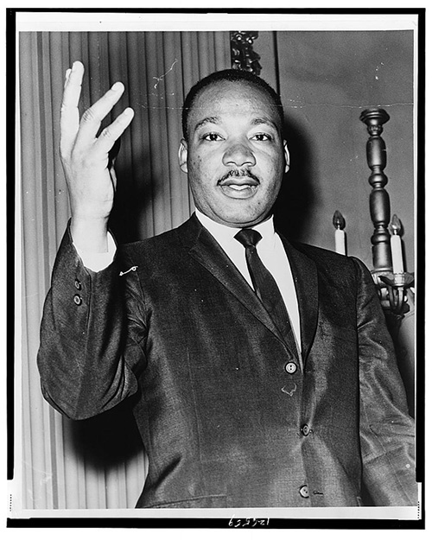
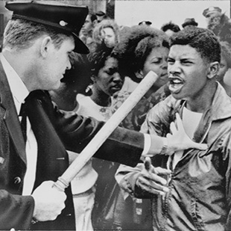

Civil Rights in the U.S.
An Overview of the 1950s and 1960s
[Dr. Martin Luther King, Jr., half-length portrait, facing front]. Dick DeMarsico, photographer, 1964. New York World-Telegram and the Sun Newspaper Photograph Collection. Prints & Photographs Division
Nashville police officer wielding nightstick holds African American youth at bay during a civil rights march in Nashville, Tennessee. Nashville Tennessee, 1964. Photograph. https://www.loc.gov/item/00652484/.

Slide 2
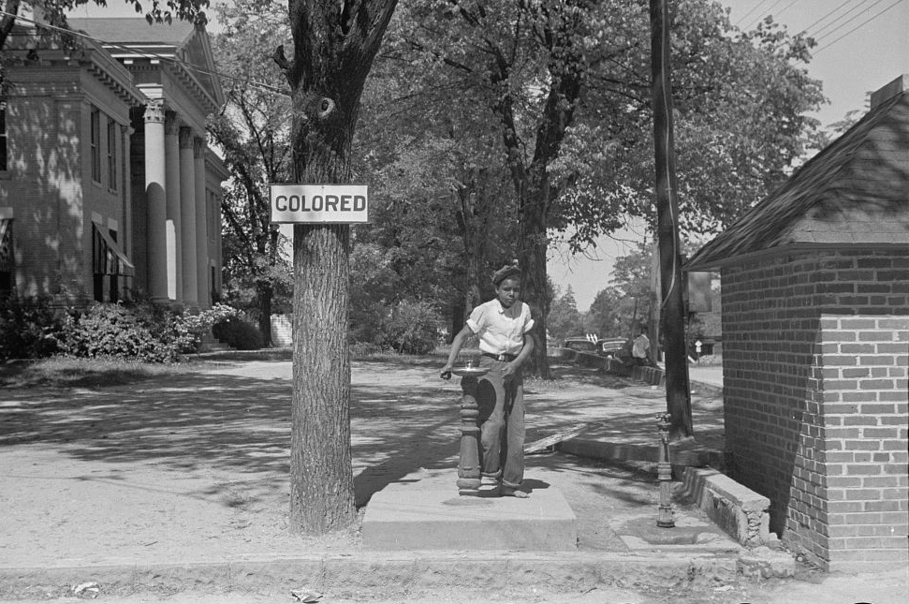
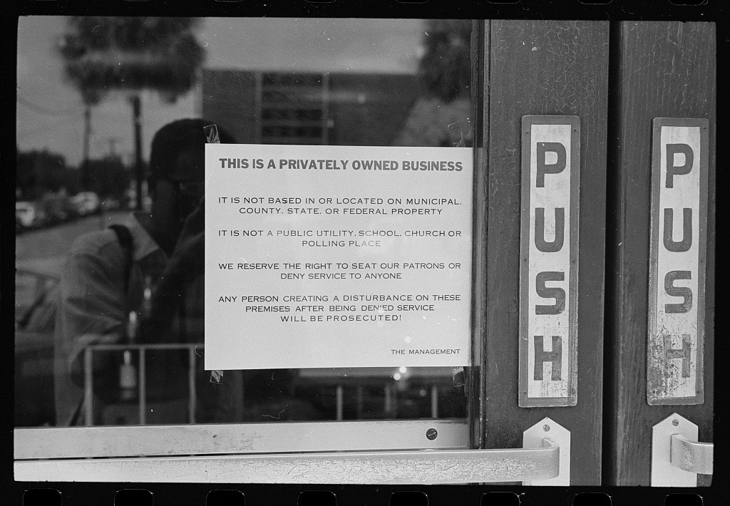
Racism and Segregation: Jim Crow Laws
This business in Albany, Georgia exclaims that because they own a private business they can “deny service to anyone” and those who object “will be prosecuted.” (1962)
Taken in Halifax, North Carolina this photograph depicts a water fountain labeled “colored” in front of the local courthouse. (1938)
Vachon, John, photographer. Drinking fountain on the county courthouse lawn, Halifax, North Carolina. Halifax Halifax. North Carolina United States, 1938. Apr. Photograph. https://www.loc.gov/item/2017717044/
Leffler, Warren K, photographer. Segregation in Albany - street scenes. , 1962. Photograph. https://www.loc.gov/item/2016646428/.
Notes:
“Jim Crow laws were a collection of state and local statutes that legalized racial segregation. Named after a Black minstrel show character, the laws—which existed for about 100 years, from the post-Civil War era until 1968—were meant to marginalize African Americans by denying them the right to vote, hold jobs, get an education or other opportunities. Those who attempted to defy Jim Crow laws often faced arrest, fines, jail sentences, violence and death.” “The North was not immune to Jim Crow-like laws. Some states required Black people to own property before they could vote, schools and neighborhoods were segregated, and businesses displayed “Whites Only” signs” https://www.history.com/topics/early-20th-century-us/jim-crow-laws
Why these images? 1) Beyond work and school, every single thing about daily life was segregated right down to the water fountains. 2) Businesses used signs like these to intimidate people and prevent them from protesting at their segregated business. Also to send a message to the community to perpetuate racist values.

Slide 3
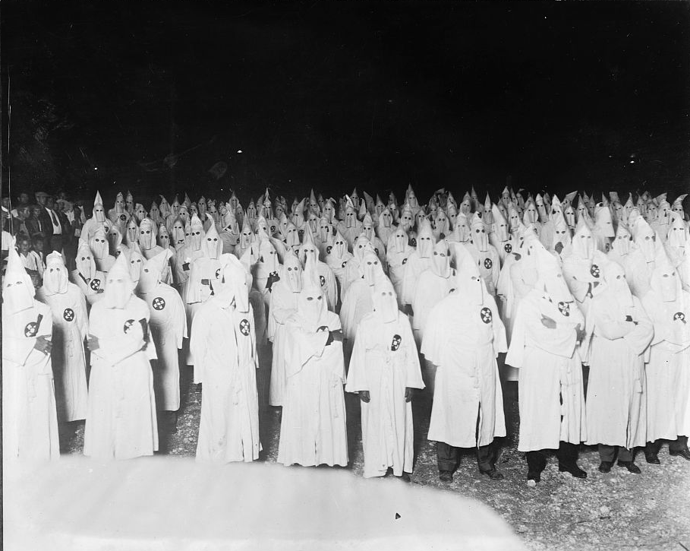
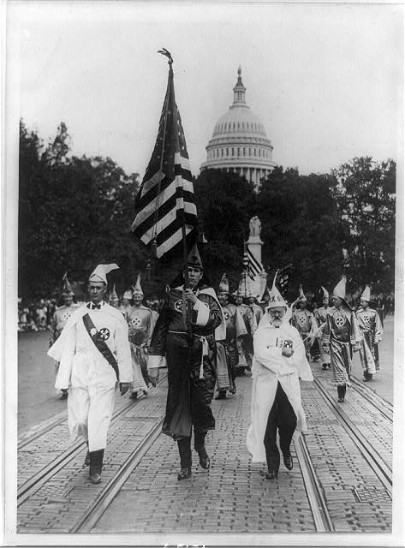
Racism and Segregation: The Klu Klux Klan
The above photo is a KKK meeting taken in 1921, showing the size of the white supremacist group.
The photo to the right is the 1926 ‘KKK Parade’ in Washington, DC. The man on the right, J.M. Fraser, is one of the founding members from Houston, TX.
Klu Klux Klan. , None. [Between 1921 and 1922] Photograph. https://www.loc.gov/item/2016824122/.
Leading the Klu sic Klux Klan parade which was held in Washington, D.C. today; on the right is Mr. J.M. Fraser, a member of the original Klan. Mr. Fraser is from Houston, Texas. Washington D.C, 1926. Sept. 13. Photograph. https://www.loc.gov/item/89706547/.
Notes:
“The most ruthless organization of the Jim Crow era, the Ku Klux Klan, was born in 1865 in Pulaski, Tennessee, as a private club for Confederate veterans. The KKK grew into a secret society terrorizing Black communities and seeping through white Southern culture, with members at the highest levels of government and in the lowest echelons of criminal back alleys.” https://www.history.com/topics/early-20th-century-us/jim-crow-laws
It is key to note the KKK’s existence in relation to racism and segregation because it is one of the many factors that undermines the legitimacy of “separate but equal.” In this case, it is the culture of violence and repugnant hatred of African Americans that maintained segregation’s power structure and terrorized Black American communities.
Why these photos? 1) Shows how many people were involved and how the level of terror they were able to instill 2) Shows their influence in DC and is representative of the racist culture. The KKK was allowed to march in Washington in 1926, but key civil rights groups in the 1960s were faced with a lot of push-back and violence.

Slide 4
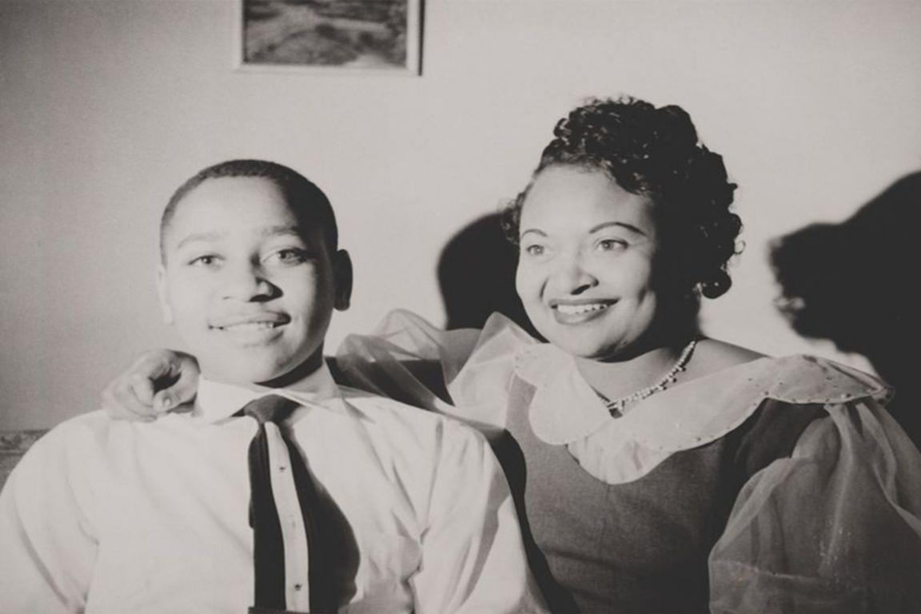
Key Moments: The Lynching of Emmett Till
Emmett Till was a 14 year old boy who was from Chicago and visiting family in Mississippi when he was brutally lynched for allegedly ‘flirting’ with a white woman. His mother’s decision to have his funeral with an open casket garnered international media attention. Many credit the powerful decision and image as a primary catalyst for the civil rights movement.
Emmett Till and his mother Mamie Till Mobley
Collection of the Smithsonian National Museum of African American History and Culture, Gift of the Mamie Till Mobley family
Notes:
“The alleged teasing of white store clerk Carolyn Bryant by the 14 year-old African American Emmett Till led to his brutal murder at the hands of Bryant’s husband Roy and his half-brother, J.W. Milam, forcing the American public to grapple with the menace of violence in the Jim Crow South. According to court documents, Till, who was visiting family for the summer in Money, Mississippi, from Chicago, purchased two-cents worth of bubble gum from the Bryant Grocery store and said, “Bye, baby” over his shoulder to Carolyn Bryant as he exited the store.
That night Roy Bryant and J.W. Milam ran into Emmett’s uncle’s home where he was staying, dragged Till from his bed, beat him to the point of disfigurement, and shot him before tossing his body into the Tallahatchie River with a cotton-gin fan attached with barbed wire laced to his neck to weigh him down. Bryant and Milam maintained their innocence and would eventually be acquitted of the murder by an all-white, all male jury. They later sold their story for $4,000 to Look magazine– bragging about the murder as a form of Southern justice implemented to protect white womanhood.
For African Americans, the murder of Till was evidenceof the decades-old codes of violence exacted upon Black men and women for breaking the rules of white supremacy in the Deep South. Particularly for Black males, who found themselves under constant threat of attack or death for sexual advances towards white women – mostly imagined – Till’s murder reverberated a need for immediate change. Carolyn Bryant testified in court that Till had grabbed her hand, and after she pulled away, he followed her behind the counter, clasped her waist, and using vulgur language, told her that he had been with white women before. At 82, some 60 years later, Bryant, confessed to Duke University professor Timothy B. Tyson that she had lied about this entire event.” https://nmaahc.si.edu/blog-post/emmett-tills-death-inspired-movement

Slide 5
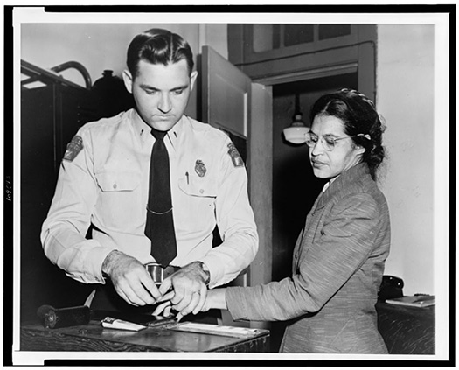
Protest and Activism: Rosa Parks
On December 1st, 1955 Rosa Parks was arrested in Alabama for refusing to give up her seat on a bus to a white man.
Key Moment in Leading To:
381 Day Long Montgomery Bus Boycott
1956 Supreme Court Case Browder v. Gayle
Woman Fingerprinted. Mrs. Rosa Parks, Negro Seamstress, whose Refusal to Move to the Back of a Bus Touched off the Bus Boycott in Montgomery, Ala. Associated Press, [Feb. 22,] 1956. New York World-Telegram & Sun Collection. Prints & Photographs Division
Notes:
100 Days After the Lynching of Emmett Till
“On the evening of December 1, 1955, Rosa Parks, an African American, was arrested for disobeying an Alabama law requiring black passengers to relinquish seats to white passengers when the bus was full. Blacks also were required to sit at the back of the bus. Her arrest sparked a 381-day boycott of the Montgomery bus system and led to a 1956 Supreme Court decision banning segregation on public transportation.” “ https://www.loc.gov/item/today-in-history/december-01/?&loclr=reclnk

Slide 6
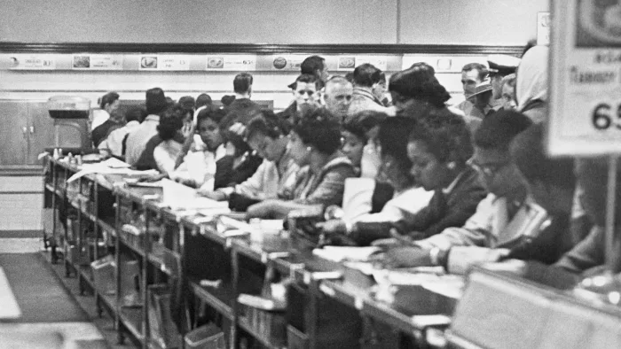
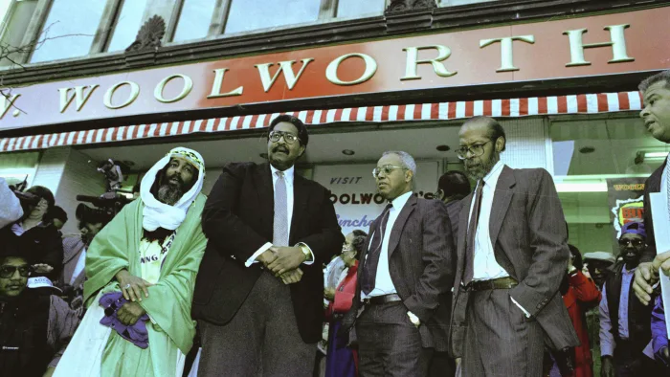
Protest and Activism: The Greensboro Four
Bettmann Archive/Getty Images
AP Photo
Sit-ins occur across the country by black college students after Greensboro Four do so at a Woolworth on February 1st 1960
The original Greensboro Four reunite in 1990 for this photograph in front of the Woolworth.
Notes:
The Greensboro sit-in was a civil rights protest that started in 1960, when young African American students staged a sit-in at a segregated Woolworth’s lunch counter in Greensboro, North Carolina, and refused to leave after being denied service. The sit-in movement soon spread to college towns throughout the South. Though many of the protesters were arrested for trespassing, disorderly conduct or disturbing the peace, their actions made an immediate and lasting impact, forcing Woolworth’s and other establishments to change their segregationist policies. https://www.history.com/topics/black-history/the-greensboro-sit-in

Slide 7
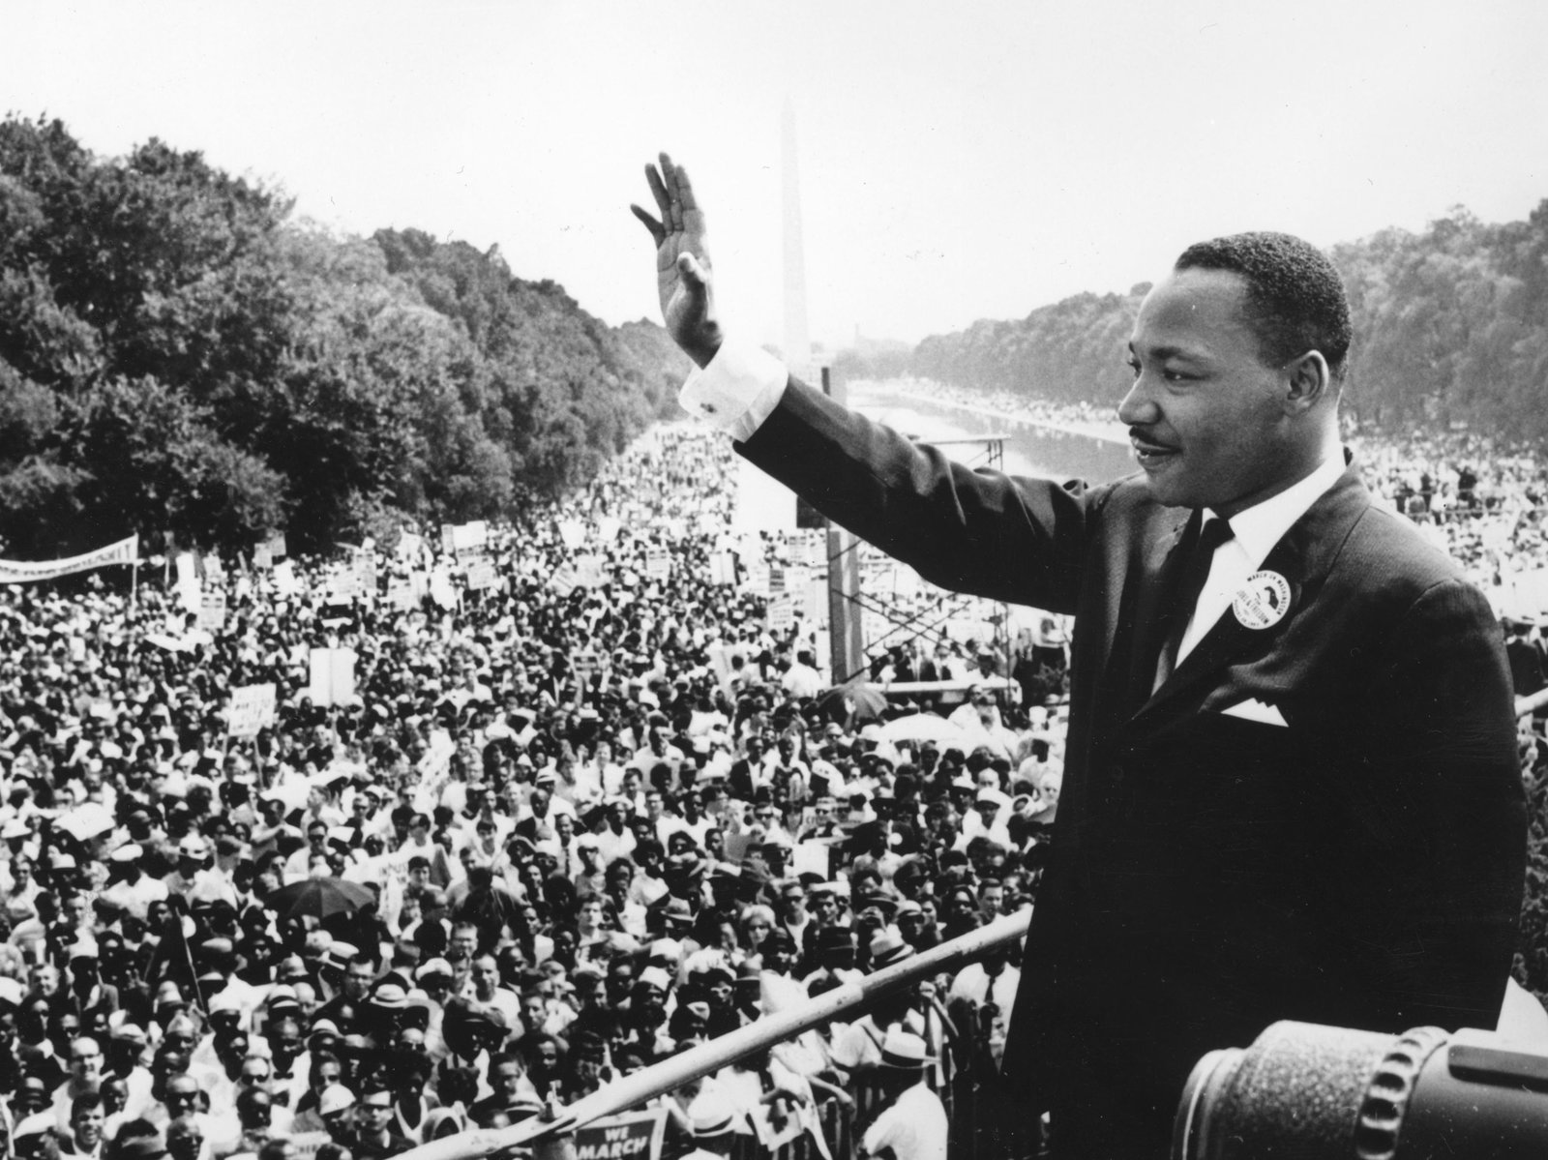
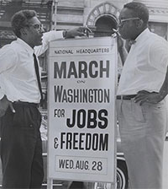
Protest and Activism: Dr. Martin Luther King Jr.
The March on Washington: August 28th, 1963
Agence France Presse/Getty Images
King delivers famous “I Have a Dream” speech in front of over 250,000 fellow protesters.
In front of 170 W 130 St., March on Washington, [l to r] Bayard Rustin, Deputy Director, Cleveland Robinson, Chairman of Administrative Committee
Notes:
“Martin Luther King, Jr. worked with a number of civil rights and religious groups to organize the March on Washington for Jobs and Freedom, a peaceful political rally designed to shed light on the injustices African Americans continued to face across the country. Held on August 28 and attended by some 200,000 to 300,000 participants, the event is widely regarded as a watershed moment in the history of the American civil rights movement and a factor in the passage of the Civil Rights Act of 1964.” https://www.history.com/topics/black-history/martin-luther-king-jr
“For many Americans, the calls for racial equality and a more just society emanating from the steps of the Lincoln Memorial on Aug. 28, 1963, deeply affected their views of racial segregation and intolerance in the nation. Since the occasion of March on Washington for Jobs and Freedom 50 years ago, much has been written and discussed about the moment, its impact on society, politics and culture and particularly the profound effects of Martin Luther King's iconic speech on the hearts and minds of America and the world. Several interviewees from the Civil Rights History Project discuss their memories of this momentous event in American history.” https://www.loc.gov/collections/civil-rights-history-project/articles-and-essays/the-march-on-washington/

Slide 8
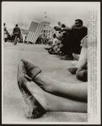
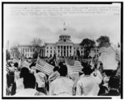
Protest and Activism: Dr. Martin Luther King Jr.
“Bloody Sunday” and the Selma to Montgomery March
Selma to Montgomery marchers wave American flags in front of the Alabama State Capitol at the end of their 5 day march. Alabama Montgomery Selma, 1965. https://www.loc.gov/item/00649672/.
A pair of muddy shoes underscore the weariness following the march from Selma to Montgomery, Alabama; state capitol in background. Alabama Selma, 1965. https://www.loc.gov/item/00652139/.
Notes:
“Bloody Sunday. In the Selma to Montgomery March, around 600 civil rights marchers walk to Selma, Alabama to Montgomery—the state’s capital—in protest of black voter suppression. Local police block and brutally attack them. After successfully fighting in court for their right to march, Martin Luther King and other civil rights leaders lead two more marches and finally reach Montgomery on March 25.” https://www.history.com/topics/civil-rights-movement/civil-rights-movement-timeline
https://www.history.com/news/selma-bloody-sunday-attack-civil-rights-movement
https://www.history.com/topics/black-history/selma-montgomery-march

Slide 9
Legacy
Key protests and activists led to major victories for the Civil Rights Movement of the 1950s and 1960s. For example:
Brown v. Board of Education (1954)
Browder v Gayle (1956)
Civil Rights Acts of 1957, 1960, and 1964
24th Amendment (No Poll Tax, 1964)
The Voting Rights Act of 1965
Fair Housing Act of 1968
Notes:
https://www.thoughtco.com/overview-civil-rights-legislation-supreme-court-104388

Slide 10
Resources
https://americanspaces.state.gov/african-american-history-toolkit-available/
http://bit.ly/NMAAHCExhb
http://bit.ly/NtlPrkAAHMLP
https://americanspaces.state.gov/programming/additional-programming-resources/national-museum-of-african-american-history-culture-program-package/

