Slide 1
Black History Month:
A Time for Recognizing the Role of African Americans in the U.S.

Slide 2
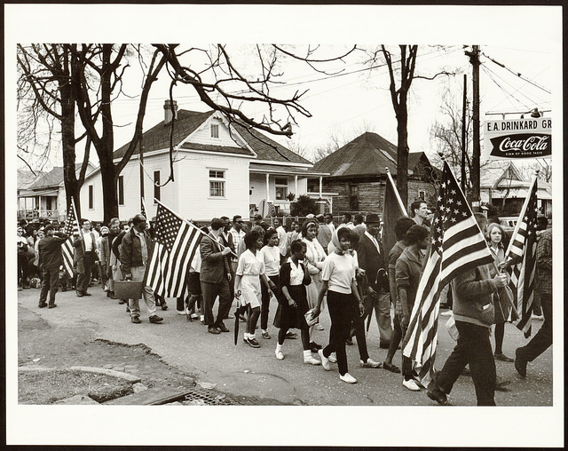
Black History Month | Reflection
“National African American History Month is a call to each and every citizen of our great land to reflect on the cultural, scientific, political, and economic contributions of African Americans, which are woven throughout American society. We remember, learn from, and build on the past, so that, together, we can build a better and more prosperous future for all Americans.”
~ President Donald J. Trump
African Americans marching in Montgomery, Alabama in 1965.
Notes:
Image: IIP Flickr
Source:
White House. (2019). “Presidential Proclamation on National African American History Month.” Retrieved from https://www.whitehouse.gov/presidential-actions/presidential-proclamation-national-african-american-history-month-2019/

Slide 3
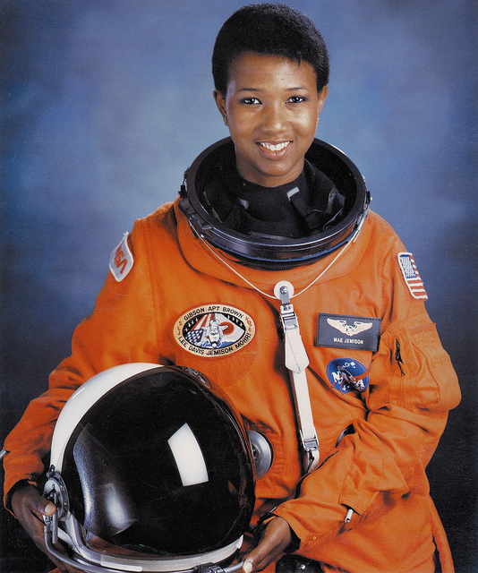
Black History Month | What is it?
Black History Month--also called African American History Month--is an annual celebration of achievements by African Americans and a time for recognizing the central role of blacks in U.S. history.
Dr. Mae Jemison, First African-American Woman in Space
Notes:
Notes:
Black History Month--also known as African American History Month--is celebrated every February in the United States.
It offers a special time of reflection and recognition of the central role that African Americans have played in American history, culture, and society.
It is a also a time of reflection on the struggles and advancement of African Americans.
Photo: IIP Flickr
Sources:
A&E Television Networks. (2018). “Black History Month.” Retrieved from https://www.history.com/topics/black-history/black-history-month

Slide 4
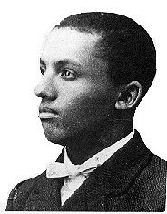
Black History Month | When did it start?
Black History Month grew out of an effort started in 1926--nearly 50 years after the passing of the 13th Amendment of the U.S. Constitution ending slavery.
Historian Carter G. Woodson, “grandfather” of Black History Month
Notes:
Notes:
Black History Month has its roots in “Negro History Week,” a commemorative week developed in 1926 by historian Carter G. Woodson.
The week was developed to celebrate the achievements of African Americans.
This was created 50 years after the passing of the 13th Amendment of the U.S. Constitution, which ended slavery in the United States.
In 1976, President Gerald Ford recognized the first National Black History Month, calling upon the public to “seize the opportunity to honor the too-often neglected accomplishments of black Americans in every area of endeavor throughout our history.”
Photo: Wikimedia Commons
Sources:
A&E Television Networks. (2018). “Black History Month.” Retrieved from https://www.history.com/topics/black-history/black-history-month

Slide 5
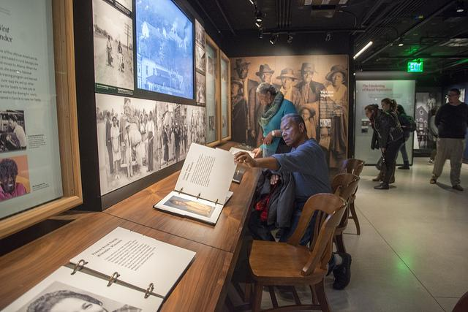
Black History Month | How do we celebrate?
Many U.S. institutions and businesses celebrate the month of February through events, exhibits, and discussions about the role of African Americans in American culture and history.
Exhibit at the National Museum of African American History & Culture
Notes:
Notes:
Many U.S. institutions (like museums and governments) offer special exhibits and activities displaying the lives of prominent and notable African Americans that highlight their contributions to American history as well as their global impacts.
U.S. businesses (like cinemas and movies theatres) may screen films and television shows highlighting famous African American actors, actresses, and other artists.
U.S. schools and universities often teach students about prominent African Americans in history and the impact of their achievements on American culture.
Photo: IIP Flickr
Sources:
A&E Television Networks. (2018). “Black History Month.” Retrieved from https://www.history.com/topics/black-history/black-history-month

Slide 6
Who are some notable figures in American history?
Notes:
Photo: IIP Flickr Album

Slide 7
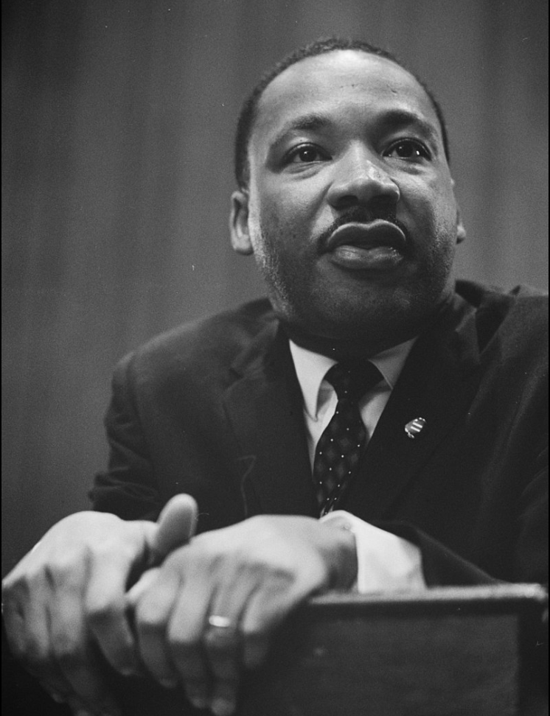
Black History Month | Notable Figures
Dr. Martin Luther King, Jr. was a prominent leader during the Civil Rights Movement in the 1950s and 1960s. He called for non-violent resistance and pushed for peace and equality.
Notes:
Notes:
Black History Month celebrates the lives and legacy of African Americans and their contributions to American history and culture.
Reverend Dr. Martin Luther King, Jr. is one of the leading figures of the Civil Rights Movement during the 1950s and 1960s.
He was an advocate for non-violent struggle to gain racial equality, most notably during the Montgomery Bus Boycott (a campaign focused on desegregating bus seating, since African Americans were forced to sit in the back), non-violent protests (for which he was arrested multiple times), and leading the March on Washington, attended by nearly 300,000 people.
Dr. King’s “I Have a Dream Speech” is one of the most famous speeches in American history. He called for peace, equality while fighting injustice.
Photo: Wikimedia Commons
Sources:
A&E Television Networks. (2018). “Martin Luther King, Jr.” Retrieved from https://www.history.com/topics/black-history/martin-luther-king-jr

Slide 8
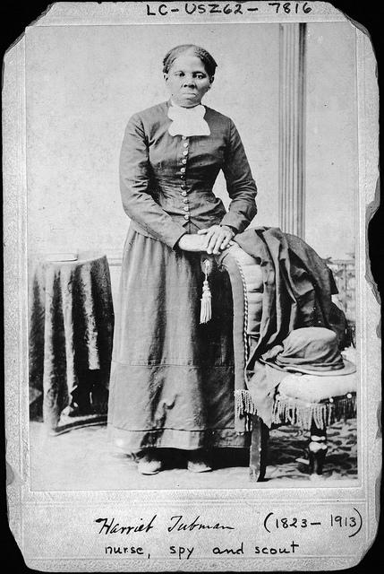
Black History Month | Notable Figures
Harriet Tubman was an abolitionist and“conductor” on the Underground Railroad, and worked directly with the U.S. military during the Civil War.
Notes:
Notes:
Harriet Tubman was a “conductor” on the Underground Railroad, a network of secret routes and safe houses used by African-American slaves escaping to freedom from the American South.
She escaped from slavery using the network of the Underground Railroad, traveling nearly 90 miles to freedom.
Using her own experience, she returned and helped nearly 70 slaves reach freedom in northern states in the U.S..
During the U.S. Civil War, she also worked with U.S. troops providing intelligence and treated sick and wounded soldiers.
Photo: IIP Flickr
Sources:
A&E Television Networks. (2019). “Harriet Tubman.” Retrieved from https://www.history.com/topics/black-history/harriet-tubman

Slide 9
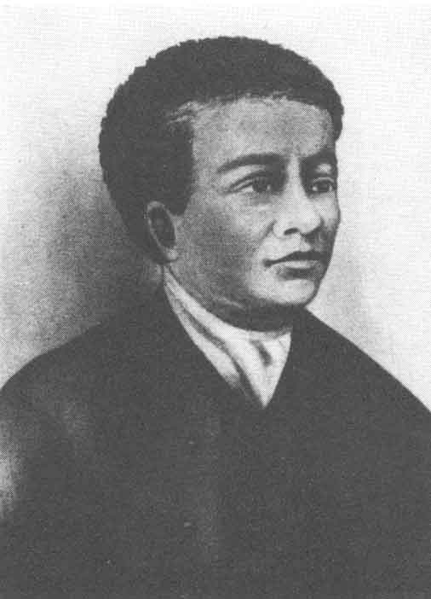
Black History Month | Notable Figures
Benjamin Banneker was an astronomist, mathematician, and urban planner. He is notable for developing accurate almanacs for farmers, surveying the land to become Washington, DC and encouraging Founder Fathers to abolish slavery.
Notes:
Notes:
Benjamin Banneker was an astronomist, mathematician, and urban planner during the 18th century.
Benjamin was born a free man in Maryland and mostly self-educated.
His interest in math and geography led him to work on planning and developing towns and cities, most notably the U.S. capital, Washington, DC.
His mathematical calculations accurately predicted eclipses and agricultural seasons. He put his information in almanacs, which were very successful with farmers.
He was also an abolitionist--calling for the end of slavery--which he often wrote to then-Secretary of State Thomas Jefferson about.
Photo: Wikimedia Commons
Sources:
Encyclopedia Britannica. (2019). “Benjamin Banneker.” Retrieved from https://www.britannica.com/biography/Benjamin-Banneker

Slide 10
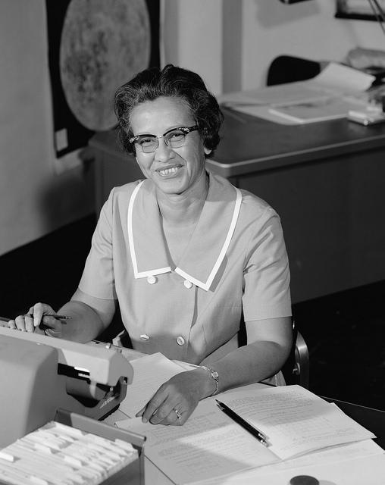
Black History Month | Notable Figures
Katherine Johnson is a mathematician most known for her work at NASA. Her calculations helped make the first U.S. manned spaceflight a success.
Notes:
Notes:
Katherine Johnson is most known for her work on the first successful NASA manned spaceflight.
Katherine was one of the first African Americans to attend a racially integrated graduate school in West Virginia in 1939.
Within 2 weeks of starting her job at National Advisory Committee for Aeronautics (the previous name for NASA), she was promoted to work on the Flights Research Division.
Her work analyzing flight tests data and trajectories was important to the success of the first manned spaceflight in 1961.
Photo: IIP Flickr
Sources:
NASA. (2018). “Katherine Johnson Biography.” Retrieved from https://www.nasa.gov/content/katherine-johnson-biography

Slide 11
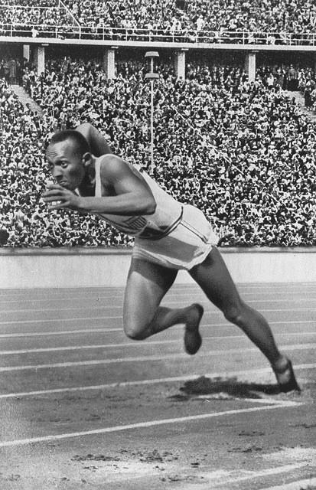
Black History Month | Notable Figures
Jesse Owens was an Olympic Gold Medalist in the 1936 in Berlin, Germany. He broke 5 world records in the track & field competitions, defying Hitler’s theory that the Aryan (white) race was superior.
Notes:
Notes:
Jesse Owens was an Olympian who broke 5 world records and earned 4 gold medals at the 1936 Olympics in Berlin, Germany.
His success at the games was notable because it directly defied Adolf Hitler’s assertion in Nazi Germany that the white race was superior.
Germans and Americans alike hailed Owens as a hero due to his outstanding performance at the Olympic Games.
Photo: IIP Flickr
Sources:
Encyclopedia Britannica. (2019). “Jesse Owens.” Retrieved from https://www.britannica.com/biography/Jesse-Owens
Olympics Committee. (2019). “Jesse Owens.” Retrieved from https://www.olympic.org/jesse-owens

Slide 12
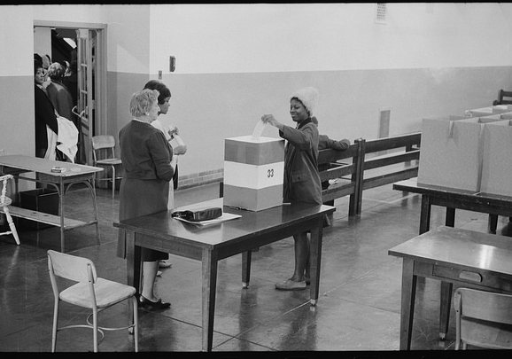
The End
Notes:
Photo: IIP Flickr

