Slide 1
Malcolm X:
Passionate Activist

Slide 2
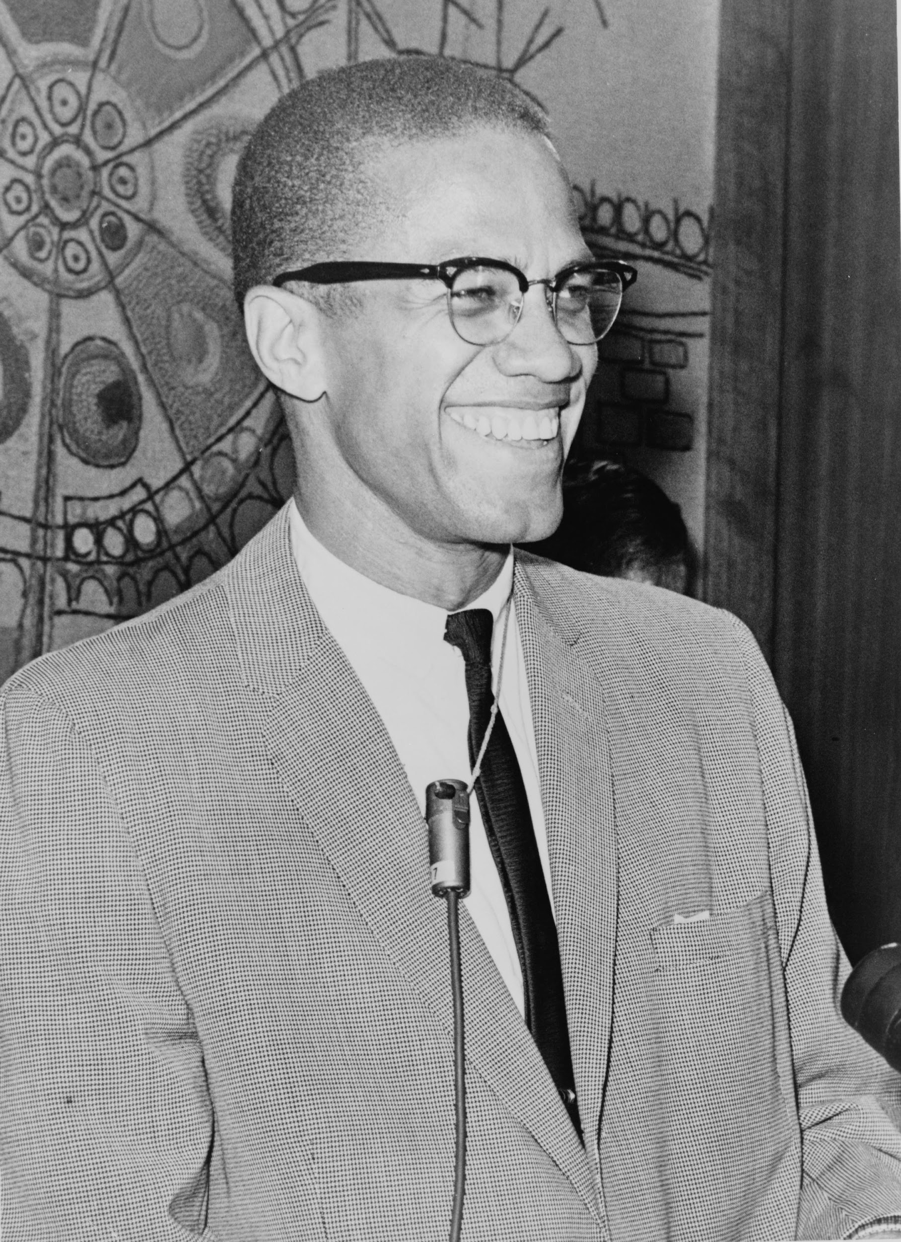
Malcolm X | Early Life
“So early in my life, I had learned that if you want something, you had better make some noise.”
Notes:
Notes:
Malcolm X was born under the name Malcolm Little in Omaha, Nebraska, a state in the American South, on May 19, 2925. Malcolm’s father was a Christian Baptist minister who worked toward the improvement of the lives of Black Americans. After receiving threats from the Ku Klux Klan (KKK), Malcolm’s father moved the family to Wisconsin and then again to Michigan.
Malcolm experienced much racism as a child. His home was burned to the ground by KKK members. After his father died in a streetcar accident (he believed to be caused by KKK), Malcolm fell into trouble after engaging in a life of crime. He was sent to jail in 1946.
Image: Wikimedia Commons
Source:
A&E Television. (2019). “Malcolm X.” Retrieved from https://www.history.com/topics/black-history/malcolm-x
PBS. (2019). “Timeline of Malcolm X’s Life.” Retrieved from https://www.pbs.org/wgbh/americanexperience/features/malcolmx-timeline-malcolm-xs-life/
X, Malcolm & Haley, A. (1965). “The Autobiography of Malcolm X.”

Slide 3
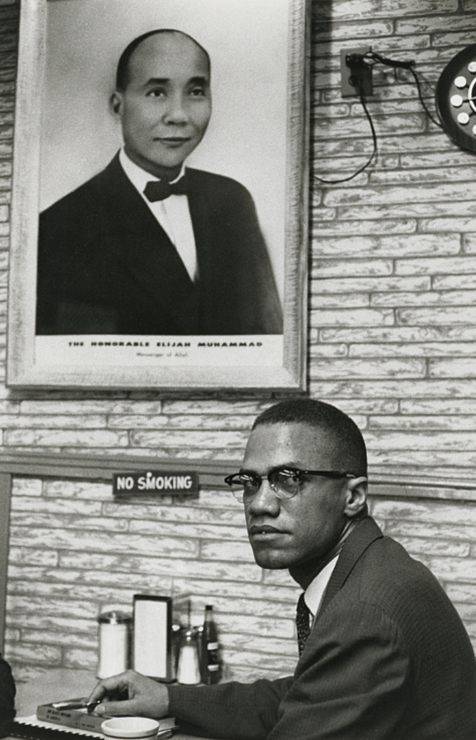
Malcolm X | Nation of Islam
"You can't separate peace from freedom because no one can be at peace unless he has his freedom."
Malcolm X sitting under a photo of Elijah Muhammad, the leader of the Nation of Islam
Notes:
Notes:
While in jail, Malcolm came into contact with the teachings of Elijah Muhammad, the leader of the Nation of Islam (also called the Black Muslims). “Muhammad’s thesis that the white man is the devil with whom blacks cannot live had a strong impact on Malcolm.” Malcolm became a preacher in the Nation of Islam and dropped his last name--”Little”--because he believed the name was given by the slave-masters that owned his ancestors. Instead, he took the name “X”, indicating that his identity was stolen.
Photo: Smithsonian National Portrait Gallery
Sources:
A&E Television. (2019). “Malcolm X.” Retrieved from https://www.history.com/topics/black-history/malcolm-x
PBS. (2019). “Timeline of Malcolm X’s Life.” Retrieved from https://www.pbs.org/wgbh/americanexperience/features/malcolmx-timeline-malcolm-xs-life/
X, Malcolm. (1965). “Speech from New York City.” Malcolm X Speaks: Selected Speeches and Statements. Retrieved from https://www.usatoday.com/story/news/nation-now/2015/02/21/malcolm-x-anniversary-death/23764967/

Slide 4
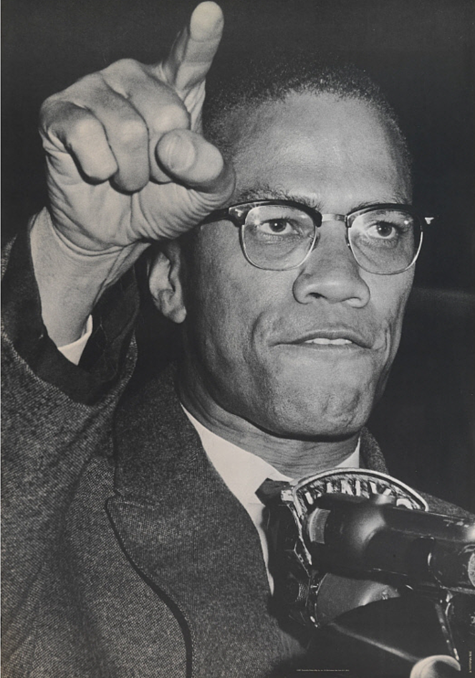
Malcolm X | Civil Rights Activist
“Whenever you’re going after something that belongs to you, anyone who’s depriving you of the right to have it is a criminal...Whenever you are going after something that is yours, you are within your legal rights to lay claim to it...”
Notes:
Notes:
When Malcolm left jail in 1952, he quickly rose to among the top leadership in the Nation of Islam. He recruited members and preached about racist behavior by whites and advocated for self-defense. Over time, however, Malcolm had issues with the Nation of Islam’s leaders, particularly Elijah Muhammad. He had pushed for the group to join the Civil Rights movement more directly and also discovered criminal behavior by members of the Nation. Malcolm X became dissatisfied and left the Nation of Islam and converted to Sunni Islam.
Photo: Smithsonian Institution
Sources:
A&E Television. (2019). “Malcolm X.” Retrieved from https://www.history.com/topics/black-history/malcolm-x
PBS. (2019). “Timeline of Malcolm X’s Life.” Retrieved from https://www.pbs.org/wgbh/americanexperience/features/malcolmx-timeline-malcolm-xs-life/
X, Malcolm. (1964). “The Ballot or the Bullet.” Retrieved from https://en.wikiquote.org/wiki/Malcolm_X

Slide 5
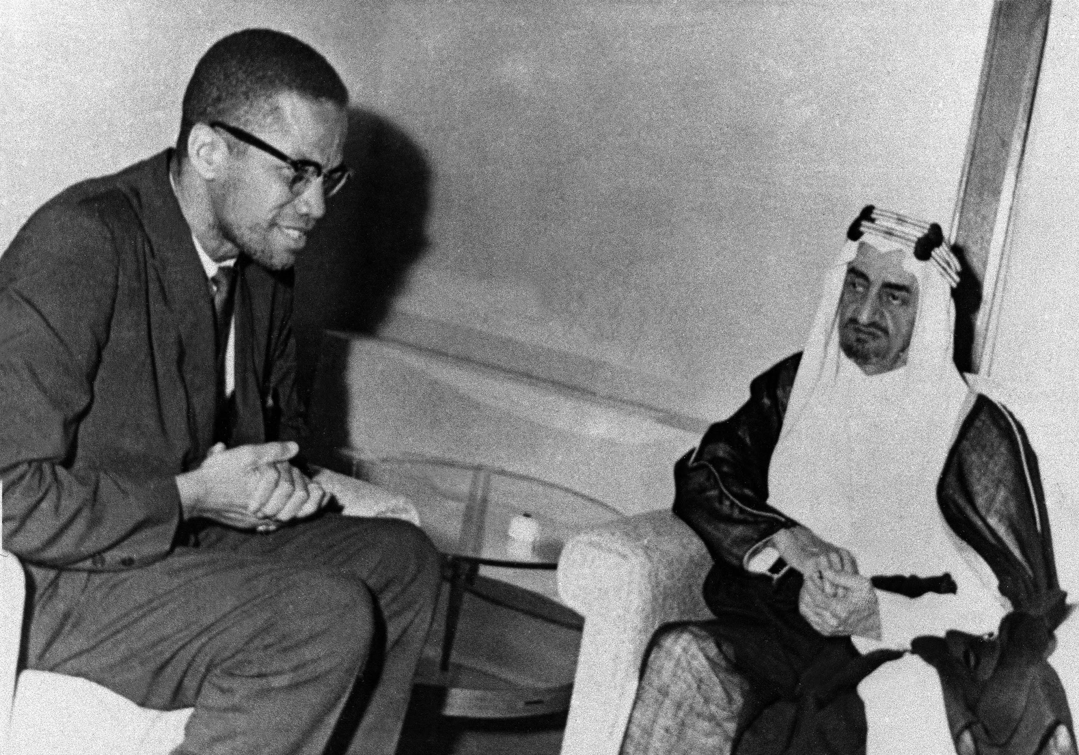
Malcolm X | The Hajj and Change
Malcolm X on his Hajj experience:
“Their sincere submission to the Oneness of God, and their true acceptance of all nonwhites as equals makes the so‐called 'whites' also acceptable as equals into the brotherhood of Islam with the 'nonwhites'. Color ceases to be a determining factor of a man's worth or value once he becomes a Muslim. I hope I am making this part very clear, because it is now very clear to me.”
Malcolm X meets with Saudi Prince Faisal while visiting Mecca for the Hajj
Notes:
Notes:
When Malcolm X went on the hajj--the Muslim pilgrimage to Mecca, Saudi Arabia--in 1964, he described it as a transformative experience. He was stunned by seeing Muslims of every race all in one place peacefully praying and worshipping God together. During his time of travel, he also visited Egypt, Lebanon, Liberia, Senegal, Nigeria, and Ghana. He met world leaders such as Ahmed Ben Bella of Algeria, Gamal Abdel Nasser of Egypt, and Kwame Nkrumah of Ghana.
During the hajj, Malcolm took on a new name: El-Hajj Malik El-Shabazz. He officially decided that the teachings of the Nation of Islam were not in-line with global practices and beliefs of Islam and began to preach Sunni Islam. He began preaching that the solution to racial problems in the U.S. lay in orthodox Sunni Islam, not in the often-violent and separatist teachings of the Nation of Islam.
Malcolm’s new-found faith did not make the leaders of the Nation of Islam happy. They were worried that his influence and new approach would harm their own efforts. Over the next year, some supporters of the Nation of Islam threatened Malcolm X and his family.
On February 21, 1965, Malcolm X was assassinated while giving a speech in New York City.
Photo: AP Photos, 1964
Sources:
New York Times. (1964). “Malcolm X Pleased by Whites’ Attitudes on Trip to Mecca.” Retrieved from https://www.nytimes.com/1964/05/08/archives/malcolm-x-pleased-by-whites-attitude-on-trip-to-mecca.html
Mamiya, L. (2019). “Malcolm X.” Encyclopedia Britannica. Retrieved from https://www.britannica.com/biography/Malcolm-X
Wisconsin Muslim Journal. (2018). “Malcolm X on his 1964 Pilgrimage to Makkah.” Retrieved from https://wisconsinmuslimjournal.org/malcolm-x-on-his-1964-pilgrimage-to-makkah/

Slide 6
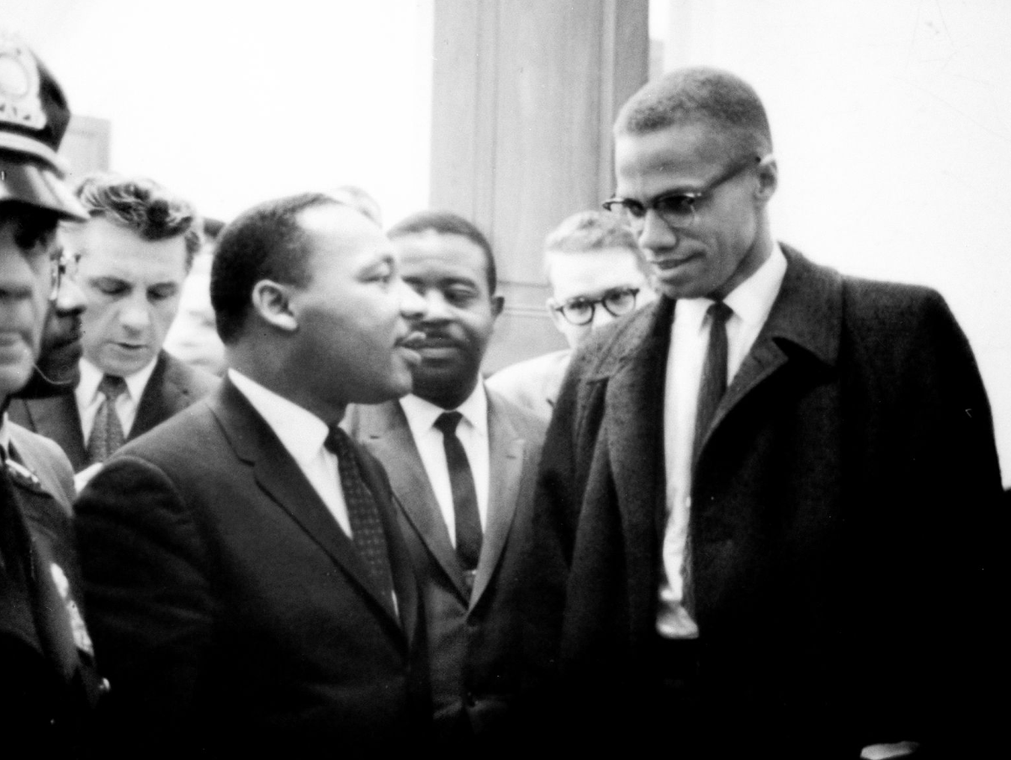
Malcolm X | Legacy as an Activist
“Ignorance of each other is what has made unity impossible in the past. Therefore we need enlightenment. We need more light about each other. Light creates understanding, understanding creates love, love creates patience, and patience creates unity. Once we have more knowledge (light) about each other, we will stop condemning each other and a United front will be brought about.”
Malcolm X standing with Rev. Dr. Martin Luther King, Jr. (left)
Notes:
Notes:
Malcolm X is viewed as an important leader of the Civil Rights movement during the 1950s and 1960s. His fiery speeches and condemnation of discrimination against African Americans gave a voice to the feelings of anger that many Black Americans felt during this time period. He pushed for change and after leaving the Nation of Islam, expressed a desire to work directly with other leaders in the Civil Rights movement. During his travels to the Middle East and Africa, Malcolm X expressed a direct connection with the plight of the communities in the colonized world. There have been many books and films made about his life and legacy.
Photo: Wikimedia Commons
Source:
A&E Television. (2019). “Malcolm X.” Retrieved from https://www.history.com/topics/black-history/malcolm-x
Clarke, J. (1990). “Malcolm X: The Man and His Times.” Retrieved from https://en.wikiquote.org/wiki/Malcolm_X
PBS. (2019). “Timeline of Malcolm X’s Life.” Retrieved from https://www.pbs.org/wgbh/americanexperience/features/malcolmx-timeline-malcolm-xs-life/

Slide 7
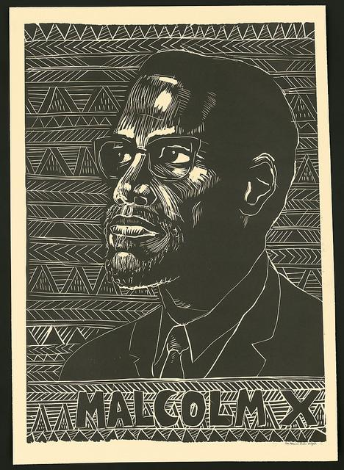
The End
Notes:
Photo: IIP Flickr Album

