Slide 1
Muhammad Ali:
Voice for Justice

Slide 2
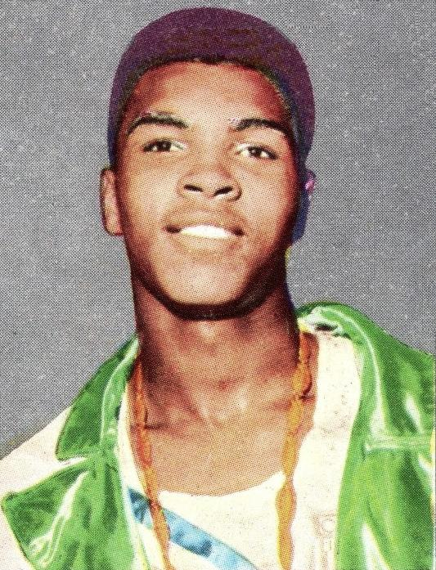
Muhammad Ali | Humble Beginnings
"Don’t count the days; make the days count."
Notes:
Notes: Muhammad Ali was born Cassius Marcellus Clay, Jr. on January 17, 1942 in Louisville, Kentucky. He began boxing at the age of 12 after a local police officer heard his bicycle was stolen. He won his first match only 6 weeks after he began training.
Image: Wikimedia Commons
Source:
Gelston, D. (2016). “In his words: Muhammad Ali’s most famous quotes.” AP News. Retrieved from https://apnews.com/1839bf32010d4ee08ad1ef32f058ca67
USA Today Sports (2016). “30 of Muhammad Ali’s best quotes.” USA Today. Retrieved from https://www.usatoday.com/story/sports/boxing/2016/06/03/muhammad-ali-best-quotes-boxing/85370850/

Slide 3
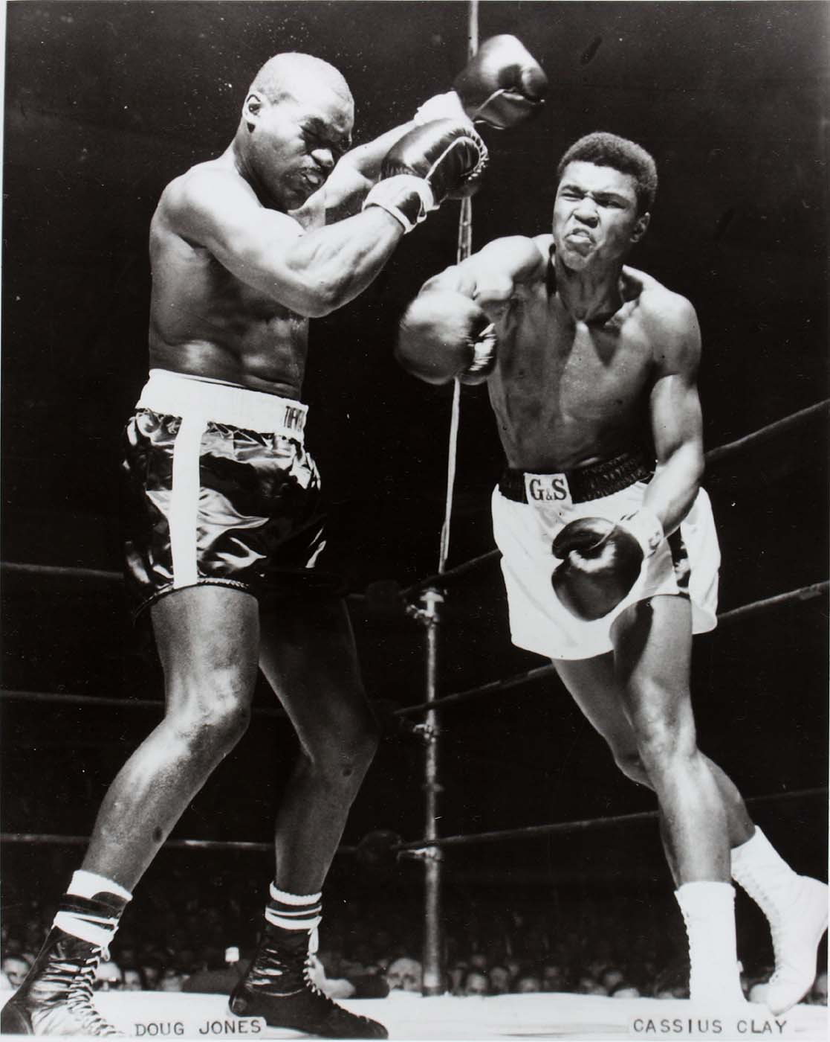
Muhammad Ali | A Boxer’s Start
“Float like a butterfly, sting like a bee.”
Notes:
Notes:
Only 6 years later, Clay won an Olympic Gold Medal in Boxing at the age of 18 while representing the United States in Rome, Italy. Over the next few years, he worked his way up in rank in the U.S. and became the Heavyweight Champion of the World in 1964. His boxing style was characterized by its speed, agility, and footwork--”a heavyweight who moved like a lightweight.”
Image: Smithsonian Insider
Sources:
Gelston, D. (2016). “In his words: Muhammad Ali’s most famous quotes.” AP News. Retrieved from https://apnews.com/1839bf32010d4ee08ad1ef32f058ca67
Hahn, Al. (2016). “What made Muhammad Ali ‘The Greatest’ in the ring?” The Conversation. Retreived from http://theconversation.com/what-made-muhammad-ali-the-greatest-in-the-ring-60521
Olympic Committee. (2019). “Muhammad ALI.” Retrieved from https://www.olympic.org/cassius-clay

Slide 4
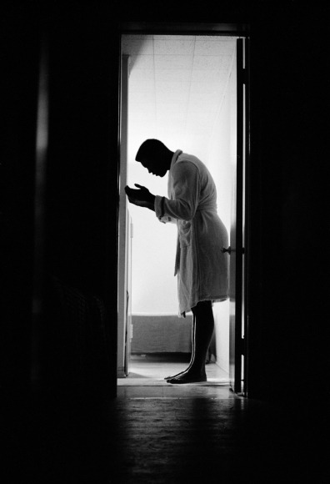
Muhammad Ali | Conversion to Islam
“We as Muslims have to stand up to those who use Islam to advance their own personal agenda. They have alienated many from learning about Islam. True Muslims know or should know that it goes against our religion to try and force Islam on anybody.”
Notes:
Notes: A few weeks later on March 6, 1964, Clay announced he had converted to Islam and taken the name Muhammad Ali. Ali’s conversion was carried out by Elijah Muhammad, the leader of a movement called the Nation of Islam, which was initially developed to improve the status of African Americans in the United States.
Throughout the rest of his life and up until his death in 2016, Ali spoke about Islam as a religion of peace and understanding.
Photo: The Tempest
Sources:
Bakdash, T. (2017). “30 Illuminating things Muhammad Ali said about Islam in his lifetime.” The Tempest. Retrieved from https://thetempest.co/2017/07/23/social-justice/30-things-muhammad-ali-has-said-about-islam/
History.com Editors (2018) “Muhammad Ali.” Retrieved from https://www.history.com/topics/black-history/muhammad-ali

Slide 5
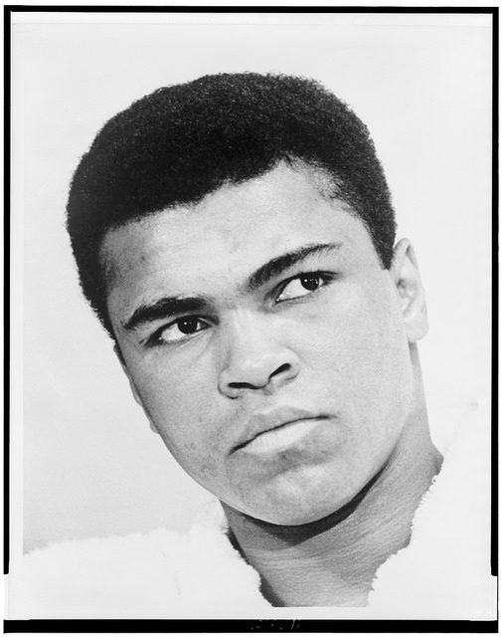
Muhammad Ali | Conscientious Objector
“My conscience won’t let me go shoot my brother, or some darker people, or some poor hungry people in the mud for big powerful America,” he had explained two years earlier. “… Shoot them for what? How can I shoot them poor people? Just take me to jail.”
Notes:
Notes: 1966, Muhammad Ali was drafted into the U.S. Army and was to be sent to fight in the Vietnam War. He refused, stating that “War is against the teachings of the Holy Qur'an. I'm not trying to dodge the draft. We are not supposed to take part in no wars unless declared by Allah or The Messenger.”
He was convicted in 1967 of violating the Universal Military Training and Service Act. Ali spent the next four years trying to appeal the decision and it made its way all the way up to the Supreme Court, the highest court in the U.S..
In 1971, the Supreme Court held that, since the appeal board gave no reason for the denial of a conscientious objector exemption for Ali, the 1967 conviction must be reversed.
Photo: IIP Flickr Album
Sources:
Brown, D. (2018).“‘Shoot them for what?’ How Muhammad Ali won his greatest fight.” Washington Post. Retrieved from https://www.washingtonpost.com/news/retropolis/wp/2018/06/15/shoot-them-for-what-how-muhammad-ali-won-his-greatest-fight/?utm_term=.c5634735a56e
Editors. (1971). “Court Clear Ali of Charge.” Eugene Register Guard. Retrieved from https://news.google.com/newspapers?id=gO5VAAAAIBAJ&sjid=PuEDAAAAIBAJ&pg=5441%2C6461911
Gelston, D. (2016). “In his words: Muhammad Ali’s most famous quotes.” AP News. Retrieved from https://apnews.com/1839bf32010d4ee08ad1ef32f058ca67

Slide 6
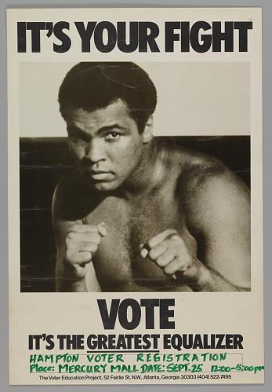
Muhammad Ali | Civil Rights Activist
“In your struggle for freedom, justice and equality I am with you. I came to Louisville because I could not remain silent while my own people, many I grew up with, many I went to school with, many my blood relatives, were being beaten, stomped and kicked in the streets simply because they want freedom, and justice and equality in housing.”
Notes:
Notes:
During the 1950s and 1960s, African Americans pushed for social justice and peace as part of the Civil Rights Movement. Many prominent African Americans used their voice to push for equal rights, including Muhammad Ali. While there were tensions between different leaders in the movement based on the various approaches for equal rights, Muhammad Ali’s fame bridged the divide and was respected and loved by all sides.
Ali was concerned about the economic advancement of the African American community. As a result, he formed a promotional corporation called Main Bout Inc, which would earn the majority of revenues from his boxing title defences and, for the first time ever, allow African Americans to enjoy most of the profits from the world's heavyweight championship.
Photo details: In this photo from the 1960s, a poster features Muhammad Ali. Above and below the portrait are three lines of very large lettering which read: [IT'S YOUR FIGHT / VOTE / IT'S THE GREATEST EQUALIZER]. The poster (shown as used in Atlanta, Georgia) was used to encourage African Americans to exercise their right to vote.
Photo: National Museum of African American History & Culture
Sources:
Ezra, M. (2016). “How Muhammad Ali influenced the Civil Rights Movement.” Al-Jazeera. Retrieved from https://www.aljazeera.com/indepth/features/2016/06/muhammad-ali-influenced-civil-rights-movement-160605055700822.html
Linton, C. (2016). “Muhammad Ali quotes on justice, war, and racism.” The Splinter. Retrieved from https://splinternews.com/muhammad-ali-quotes-on-justice-war-and-racism-1793857266

Slide 7
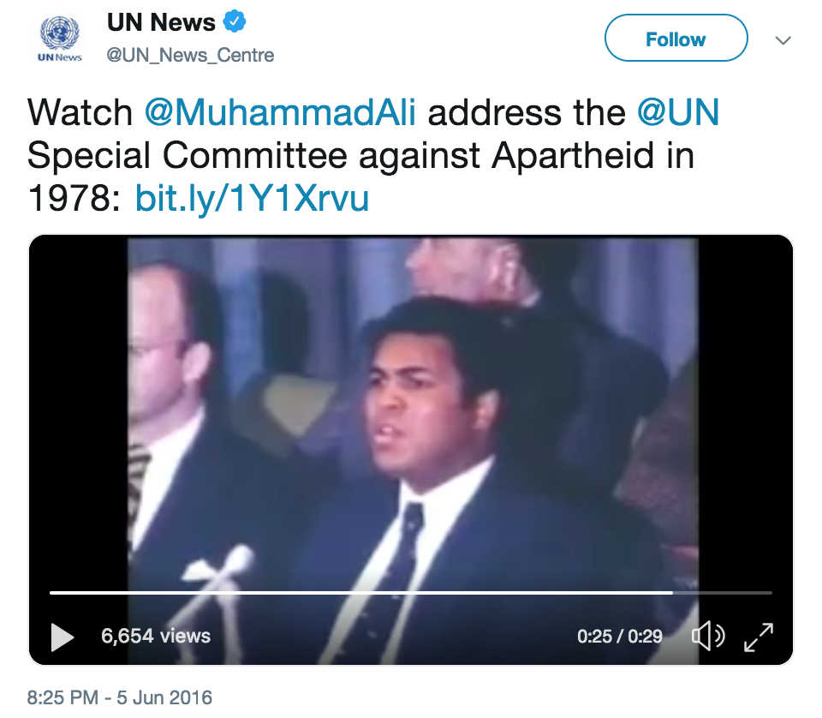
Muhammad Ali | Legacy as an Activist
“All I can do is fight for truth and justice. I can’t save anybody.”
Click here to view video
Notes:
Notes:
Muhammad Ali was diagnosed with Parkinson’s Disease in 1984, whose symptoms include tremors and changes in speech. Even though he retired from boxing, he remained in the spotlight pushing for various causes. Including:
Negotiating the release of American hostages from Iraq in 1990
Lighting the Olympic flame at the 1996 Olympics in Atlanta
Serving as the United Nations Messenger of Peace in Afghanistan in 2002
His charitable support for UNICEF, Save the Children, the Special Olympics, BeatBullying, and many more.
Photo:
Source:
Gelston, D. (2016). “In his words: Muhammad Ali’s most famous quotes.” AP News. Retrieved from https://apnews.com/1839bf32010d4ee08ad1ef32f058ca67
History.com Editors (2018) “Muhammad Ali.” Retrieved from https://www.history.com/topics/black-history/muhammad-ali
Editors. (2019). “Muhammad Ali: Charity Work and Causes.” Look to the Stars. Retrieved from https://www.looktothestars.org/celebrity/muhammad-ali

Slide 8
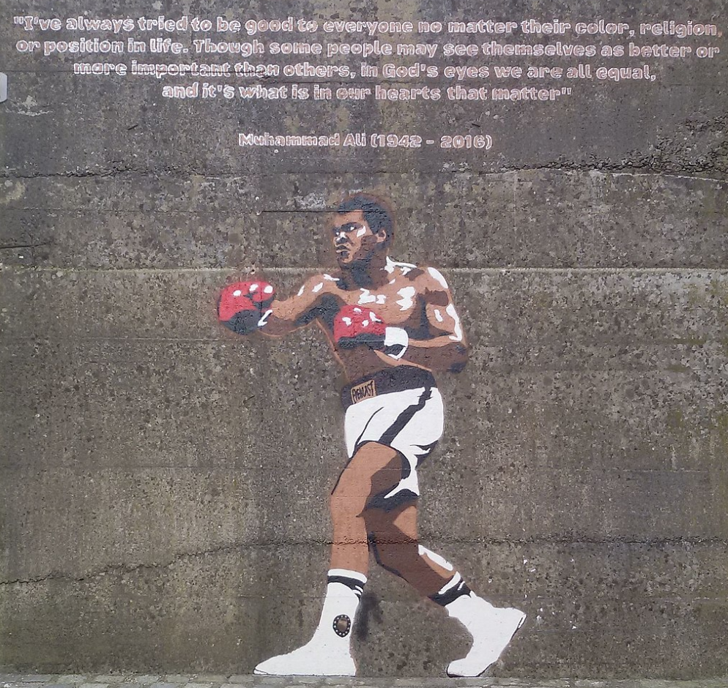
Muhammad Ali | Legacy of “The Greatest”
“What I suffered physically was worth what I’ve accomplished in life. A man who is not courageous enough to take risks will never accomplish anything in life.”
Notes:
Notes: Muhammad Ali passed away on June 3, 2016 in Scottsdale, Arizona. In all, Muhammad Ali was an “Olympic gold medalist and the first fighter to capture the heavyweight title three times, Ali won 56 times in his 21-year professional career. Ali’s outspokenness on issues of race, religion and politics made him a controversial figure during his career, and the heavyweight’s quips and taunts were as quick as his fists.”
Photo: Wikimedia Commons
Source:
Gelston, D. (2016). “In his words: Muhammad Ali’s most famous quotes.” AP News. Retrieved from https://apnews.com/1839bf32010d4ee08ad1ef32f058ca67
History.com Editors (2018) “Muhammad Ali.” Retrieved from https://www.history.com/topics/black-history/muhammad-ali

Slide 9
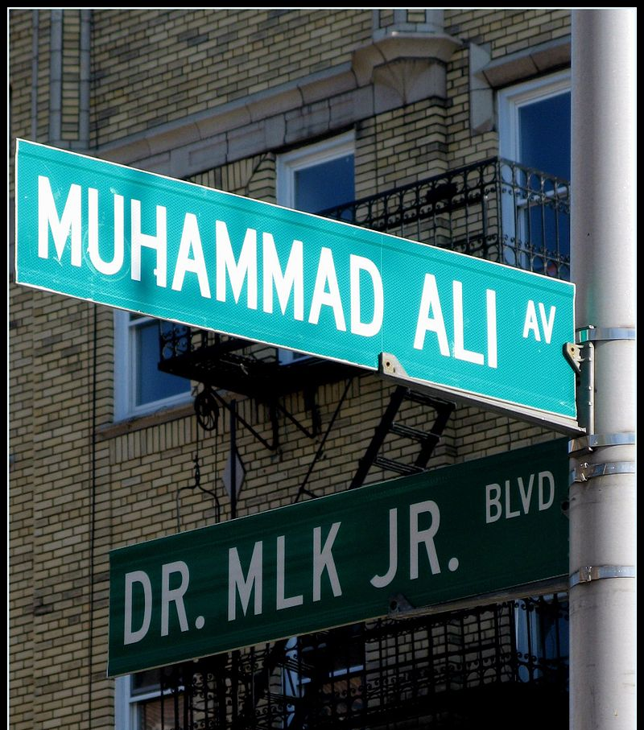
The End
Notes:
Photo: Wikimedia Commons

