Slide 1
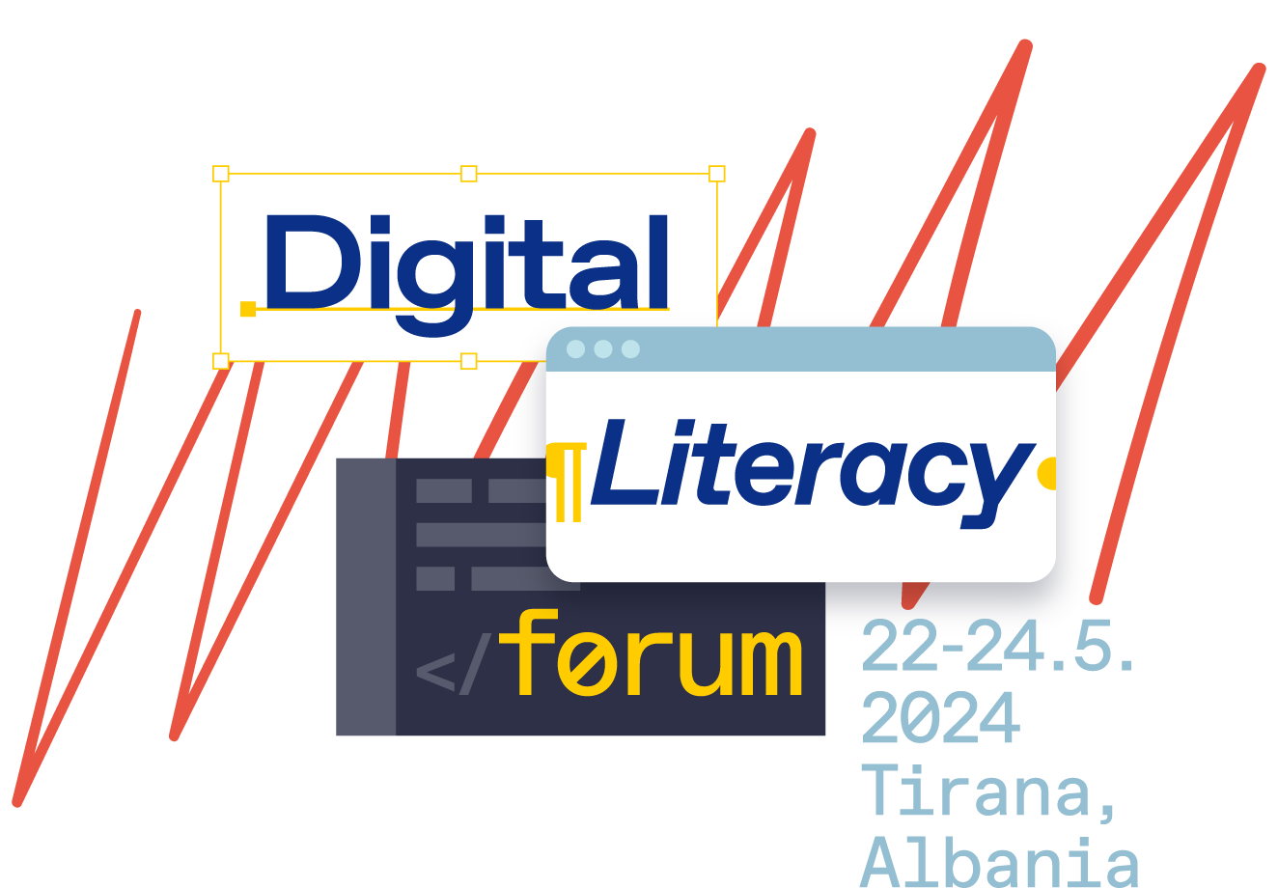

Slide 2
How computers learn – Basics of AI

Slide 3
How do people learn?

Slide 4
How do people learn?
Training
Test

Slide 5
What is artificial intelligence (AI)?
AI or artificial intelligence is a technology that enables computers to learn, think and solve problems like humans.
AI is all around us and is used in many applications that we use every day.

Slide 6
Different types of learning in AI
Supervised learning
Computers learn by the examples we show them. We give them data and tell them what this data represents. For example, we show pictures of cats and say 'this is a cat.
Unsupervised learning
Computers try to find patterns and meaning in data on their own without our guidance. They analyze the data and look for similarities and differences.

Slide 7
How do computers learn?
Computers learn from the data we give them. Data can be images, words, numbers, or any other information that computers can use to recognize patterns and make decisions.

Slide 8
LEARNING
TRAINING
EXIT

Slide 9
Examples of AI in everyday life
YouTube uses AI to suggest videos you're likely to like based on what you've watched before.
Amazon uses AI to recommend products you might like based on your purchase history.
Facebook uses AI to recognize faces in photos and suggest tagging your friends
Siri and Google Assistant: These smart assistants use AI to answer questions, set reminders, and control smart devices.

Slide 10
Examples of AI in everyday life
AI helps cars drive themselves, recognize obstacles and follow traffic.
Spam filters: Email services use AI to identify and filter spam.
Google Translate uses AI to translate text from one language to another.
Cameras on phones use AI to improve photo quality and recognize faces.

Slide 11
Creative work with AI
Resources
There are many online resources and tools that can help you get started with AI projects. Some of the popular tools are Scratch, mBlock, Google Teachable Machine, and MIT App Inventor.
Learning to code
If you want to learn how to write your own code, you can start with simple programming languages, this will help you better understand how AI works.
Simple projects
Start with simple projects like image recognition or building simple chatbots. As you progress, you can move on to more complex projects.

