Slide 2
Online Behavior

Slide 3
01 Human Rights on the Internet
02 Online Violence/ Hate Speech
03 Cyberbullying
04 Cancel Culture
05 Deepfake Technology
TABLE OF CONTENTS

Slide 4
Human Rights on the Internet

Slide 5
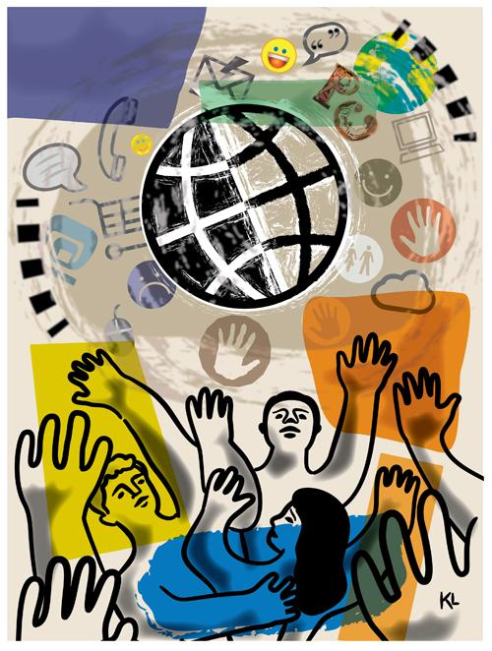
Human Rights vs. Human Rights on the Internet

Slide 6
HUMAN RIGHTS are rights inherent to all human beings, regardless of race, sex, nationality, ethnicity, language, religion, or any other status. Human rights include the right to life and liberty, freedom from slavery and torture, freedom of opinion and expression, the right to work and education, and many more.

Slide 7
the charter of human rights and principles for the internet

Slide 8
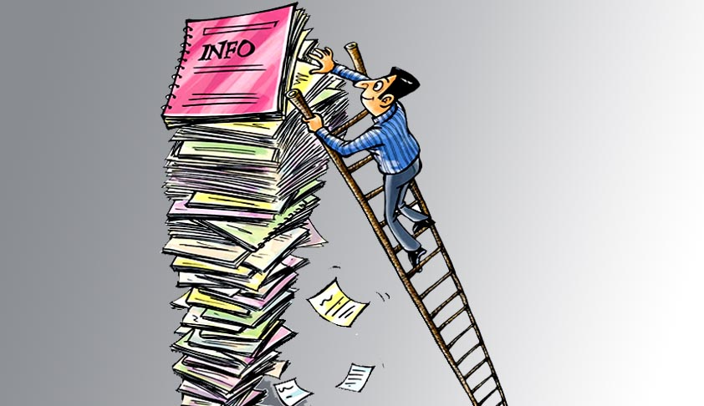
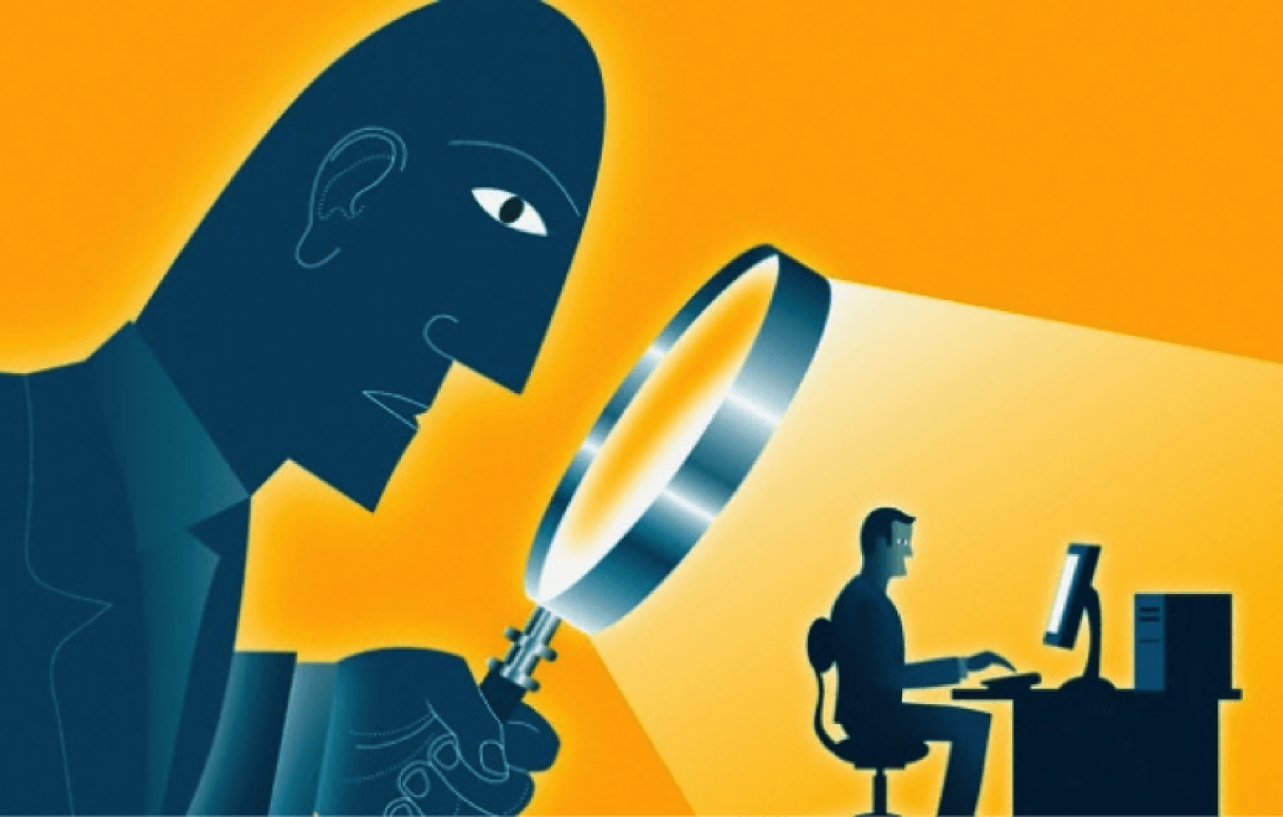
Basic Human Rights Related to the Internet

Slide 9
Basic Rights Related to the Internet:
Freedom of speech
Right to work
Right to education
Right to information
Right to privacy

Slide 10
"…, it made me think."
Example:
I tried to access a university site to get more info for my project paper, but had to pay to get more info, it made me think.
I tried to express my disagreement on a political situation, but the administrator blocked me, it made me think.

Slide 11
For More Information
Human Rights Overview
(https://egov.ufsc.br/portal/sites/default/files/human_rights_and_the_internet_a_review_of.pdf)
The Implications for Human Rights in the Digital Age­­
Deep Future (Tactical Tech)
(https://www.rand.org/pubs/commentary/2021/09/the-implications-for-human-rights-in-the-digital-age.html)
Harnessing Human Rights on the Internet
(https://www.un.org/en/academic-impact/harnessing-power-internet-support-human-rights)

Slide 12
Online Violence/ Hate Speech

Slide 13
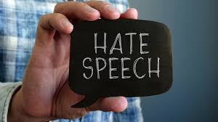
Have you ever encountered any form of hate speech? How did it make you feel?
WHAT IS

Slide 14
KEY WORDS
Hate speech is any form of expression through which speakers intend to vilify, humiliate, or incite hatred against a group or a class of persons on the basis of race, religion, skin color, sexual identity, gender identity, ethnicity, disability, or national origin.
Online hate is posting and sharing hateful and prejudiced content against an individual, group or community. It can take the form of derogatory, demonizing and dehumanizing statements, threats, identity-based insults, pejorative terms and slurs.
Cancel culture a way of behaving in a society or group, especially on social media, in which it is common to completely reject and stop supporting someone because they have said or done something that offends you.
Freedom of speech is the right to speak, write, and share ideas and opinions without facing punishment from the government.
Digital space refers to what is displayed on the screen of a digital device (e.g. laptops, computers, tablets, or smartphones).
SM User Agreement refers to a legal document that outlines the rules, guidelines, and conditions users must agree to abide by when using a particular social media platform

Slide 15
"We must confront bigotry by working to tackle the hate that spreads like wildfire across the internet."
ANTÓNIO GUTERRES,
United Nations Secretary-General, 2023

Slide 16
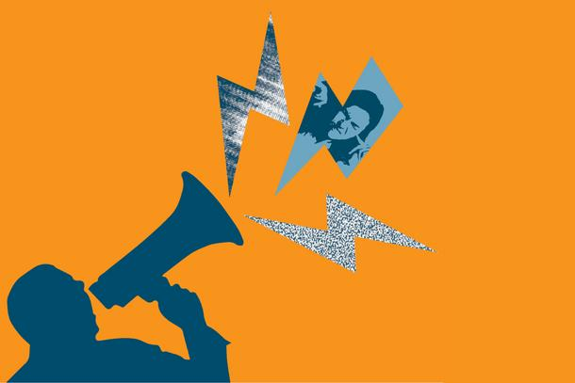
Spinning Wheel Activity
What is the impact of hate speech on individuals and communities, both online and offline?

Slide 17
Form a group. Each group finds examples of online content (articles, social media posts, comments, etc.) containing hate speech.
Switch examples, analyze the content and identify the elements of hate speech present.

Slide 19
Role-play scenarios where students encounter hate speech online and practice responding appropriately.

Slide 20
Let's REFLECT
What have we learned?

Slide 21
For More Information
https://futurefreespeech.org/hate-speech-case-database/
https://en.wikipedia.org/wiki/Hate_speech_laws_by_country
https://www.linkedin.com/pulse/freedom-speech-versus-hate-cancel-culture-conundrum-jasmine-lovell
https://www.wimbledoncollege.org.uk/_site/data/files/safeguarding/parent-guides/7CC371A7937DA2B64AD9DB3558EF4FE8.pdf
https://www.mminstitute.org/wp-content/uploads/2022/04/Analysis-of-narratives-containing-hate-speech-and-disinformation-1.pdf
https://www.mminstitute.org/wp-content/uploads/2023/06/uvrede-i-mrznja_III-dio.pdf
Boys and Girls on Stereotypes
Prejudice
"Different“ short movie

Slide 22
Cyberbullying

Slide 23
What is Cyberbullying?
Cyberbullying is bullying that takes place over digital devices like cell phones, computers, and tablets. Cyberbullying can occur through SMS, Text, and apps, or online in social media, forums, or gaming where people can view, participate in, or share content.

Slide 24
Types of Cyberbullying
Harassment
Continuous and persistent pattern of sending hurtful or threatening online messages with the intention of causing harm to the recipient.
Exclusion
ntentionally leaving someone out.
Outing/Doxing
Deliberate disclosure of sensitive or personal information about someone without their consent, aiming to embarrass or humiliate them.
Cyberstalking
Monitoring, false accusations and threats, often accompanied by offline stalking behaviors.
Trolling
Deliberate act of upsetting others by posting inflammatory comments online.
Flaming
Posting insults and profanity about the target or directly sending them hurtful messages.
Fake profiles
Fake social media accounts set up with the intention of damaging a person or brand's reputation.
Denigration
A cyberbully denigrates a victim by sending, posting, or publishing false information online about the individual.
Impersonation
A cyberbully can impersonate a victim by posting comments on social media and chat rooms in the individual's name.

Slide 25
Impact of Cyberbullying
The effects can last a long time and affect a person in many ways:
Mentally - feeling upset, embarrassed, stupid, even angry
Emotionally - feeling ashamed or losing interest in the things you love
Physically - tired (loss of sleep), or experiencing symptoms like stomach aches and headaches

Slide 26
Tips for Preventing Cyberbullying
Educate yourself
Protect your password
Never open unidentified or unsolicited messages
Log out of online accounts
Pause before you post
Raise awareness
Setup privacy controls
"Google" yourself
Don't cyberbully others
Keep photos “PG" (parental guidance)

Slide 27
Cancel Culture

Slide 28
What is the purpose of this activity?
UNDERSTAND the concept of cancel culture
DISCERN credible information from sensationalized content by evaluating online evidence
ANALYZE different perspectives on cancel culture, considering both its potential benefits and drawbacks
REFLECT on the long-term consequences of cancel culture on society (diversity of opinion, mental health, accountability etc.)

Slide 29
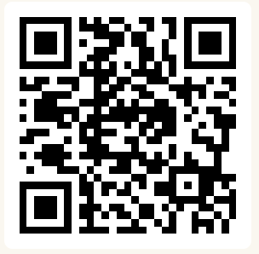
Brainstorm
What are some other denominators for human beings?
https://www.slido.com/
(scan the QR code and post your answers in the Word Cloud)

Slide 30
Is there anything wrong with
J.K. Rowling's tweet?
Give arguments!

Slide 31
Research on the topic in 4 groups
GROUP 1
Who is involved? What is the target audience of this message?
GROUP 2
Identify 2-3 techniques used to convey the message.
GROUP 3
Is the message problematic? Why? How did the others react to it?
GROUP 4
Can you identify a similar local situation? How was it reflected in the media? What were the reactions to it?

Slide 32
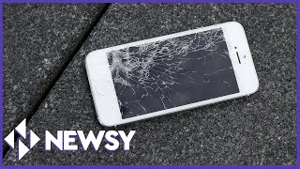
What is Cancel Culture?
Watch this video
to better understand.

Slide 33
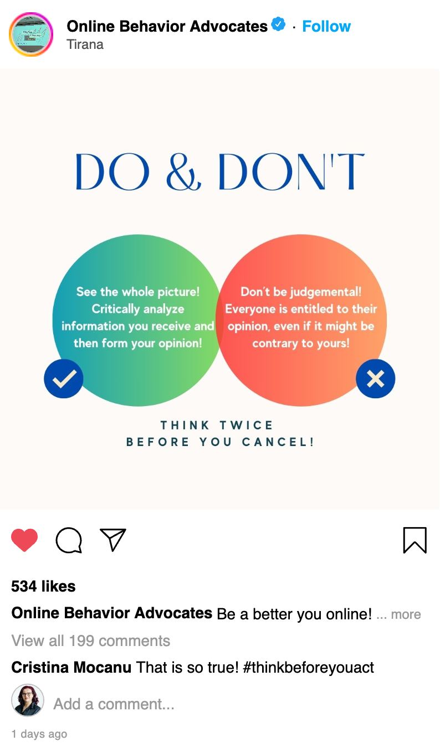
Get Creative!
Using https://zeoob.com/, create a social media mock post to reflect your views on the topic of Cancel Culture.
Share mock posts with your group!

Slide 34
Reflect!
THINK
What did you learn today?
What is cancel culture to you?
What are some strategies to avoid cancel culture?
SHARE YOUR THOUGHTS
Has anything changed in your perspective on online behavior?
How easy/difficult was it for you to create the mock posts?
How did you feel doing all these activities?

Slide 35
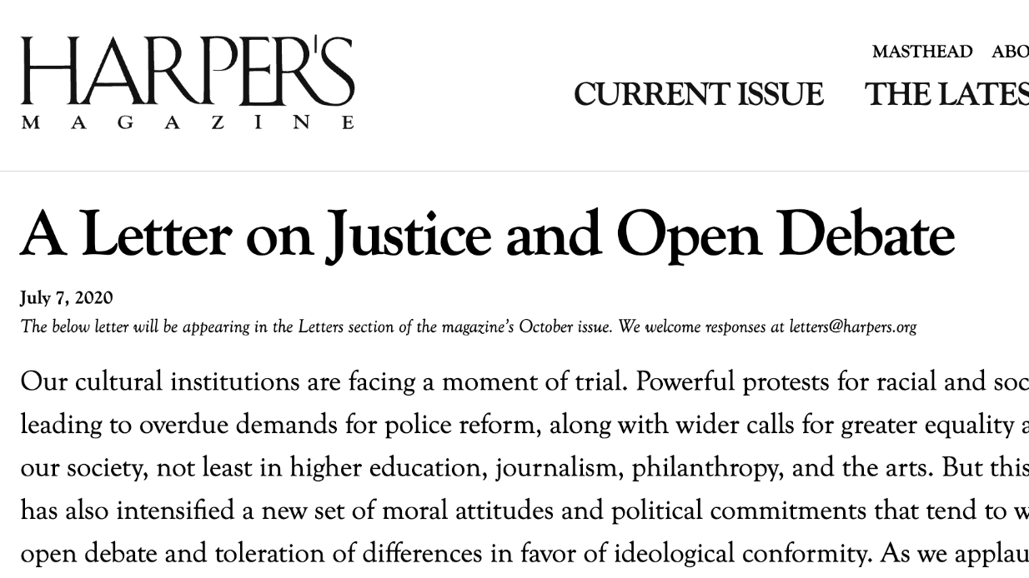
READ MORE!
Read the letter and answer the following questions:
Is cancel culture a product of popular culture or academia?
What are some solutions to the growing impact of cancel culture?
Should language change/adapt to convey new realities of the 21st century?
https://harpers.org/a-letter-on-justice-and-open-debate/

Slide 36
Deepfake Technology

Slide 37
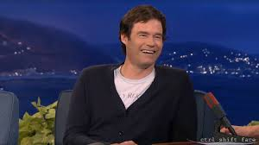
Watch the news story at the link on the right.
Can you trust your eyes?

Slide 38
What is deepfake technology?
Deepfakes are videos or photos that are manipulated from their original version to appear real.
They are generated for a variety of purposes:
Entertainment
Maintain Privacy (through avatars) on the internet
Manipulation
Fraud

Slide 39
How do you spot a deepfake?

Slide 40
Think about it:
Is the use of deepfake technology ethical?
What are the global implications of a bad actor utilizing deepfake technology?
And what about personal implications?

Slide 41
Responsible Online Communication

Slide 42
Potential Dangers of Deepfakes
Experts fear that deepfake videos and photos can be used to alter public perception, and potentially be used to impact everything from personal decisions (scams) to national politics.

Slide 43
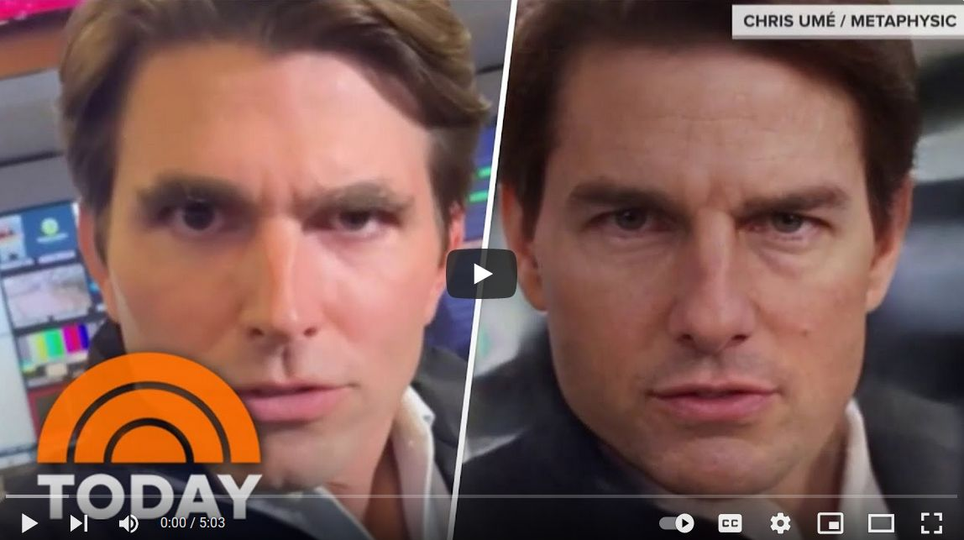
Watch the news story at the link on the right.
Can you trust your eyes?

Slide 44
Spotting deepfakes
Facial expressions and anomalies: Look for unnatural facial expressions, mismatched lip-sync or irregular blinking.
Audio discrepancies: Listen carefully for shifts in tone, pitch, or unnatural speech patterns when in doubt about a video's authenticity.
Surroundings: Examine the video for visual distortions, blurring, or inconsistent lighting. Consider whether the person in the video could realistically be in that setting.
Context and content: Analyze whether the behavior or statements in the video align with the individual's known characteristics. For example, a video featuring a public figure like Barack Obama using certain language about an opponent would be highly suspicious.
Verify the source: Confirm the credibility of the media by checking its source. Is it coming from a reliable and reputable source, or is it being posted by a random YouTuber or a social media account? Such accounts may raise suspicions.
Source: The Economic Times, Nov. 10, 2023

Slide 45
For More Information
Deepfake Overview
https://www.discoverdatascience.org/articles/everything-you-need-to-know-about-how-to-use-deepfake/
Deep Future (Tactical Tech)
https://youtu.be/LarVQRTnGo0
Positive Application of Deepfake Technology
https://www.dataart.com/blog/positive-applications-for-deepfake-technology-by-max-kalmykov
Seeing Is No Longer Believing
https://www.thomsonreuters.com/en-us/posts/technology/practice-innovations-deepfakes

Slide 46
Responsible Online Behavior
Think About It: What does it mean to behave responsibly online?

